Slide 1
Automatic Classification of Environmental Sounds with Convolutional Neural Networks (CNNs) Using Multi-Feature Channels
LELLA KRANTHI KUMAR
405119002

Slide 2
Abstract
With the advancement of Deep Neural Networks (DNN), the accuracy of sound classification such as Urban Sound Classification, Environmental Sound Classification etc., has been significantly improved. In this project, we propose a model that uses Convolutional Neural Networks (CNN) to identify sound based on the spectrograms for different sound samples collected. The model can be used for detection of deforestation, detection of shooting in urban areas and detection of strange noises at odd hours in streets such as Air Conditioner, Car Horn, Children Playing, Dog bark, Drilling, Engine Idling, Gun Shot, Jackhammer, Siren, Street Music etc.,

Slide 3
Challenges
Environmental sound work has two major obstacles, namely the lack of audio data labelled.
Previous work focused on audio from carefully produced films or TV tracks from particular environments such as elevators or office spaces and commercial or proprietary datasets.
Classification of sounds in to the semantic groups may vary from study to study.
The goal of this Project is to address the two challenges mentioned above.

Slide 4
Dataset
The dataset is called UrbanSound8K and contains 8732 labelled sound.
Urban sounds from 10 classes.
10 classes, namely: Air Conditioner Car Horn Children Playing Dog bark Drilling Engine Idling Gun Shot Jackhammer Siren Street Music The attributes of data are as follows: ID Unique ID of sound excerpt Class type of sound.
The dataset contains 8732 sound excerpts (<=4s) of urban sounds

Slide 5
Problem statement
It will show how to apply Deep Learning techniques to environmental recognition sounds, focusing specifically on recognizing unique Environmental sounds.
If we give an audio sample of a few seconds duration in a computer-readable format (such as a.wav file), we want to be able to determine whether it contains one of the target Environmental sounds with a corresponding classification accuracy score.
Optional GPU configuration initialization.

Slide 6
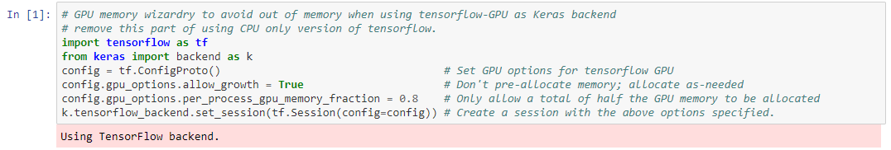
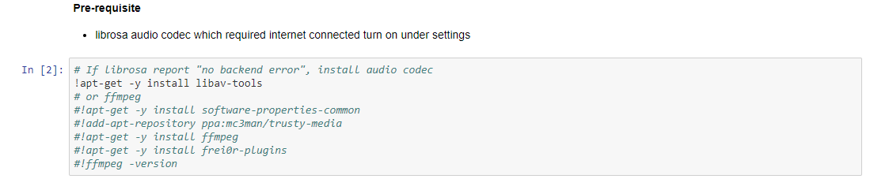
Code Execution

Slide 7
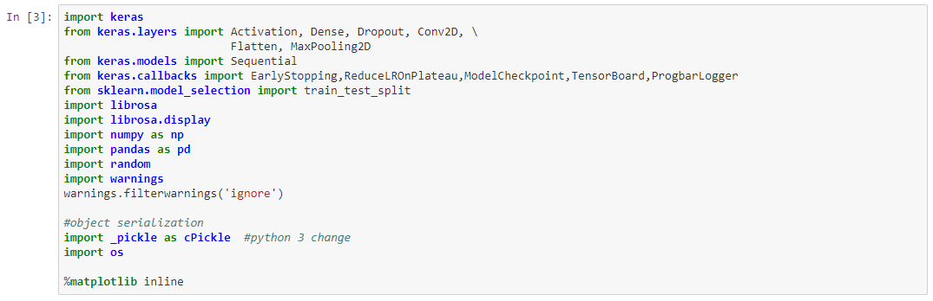
Import libraries

Slide 8
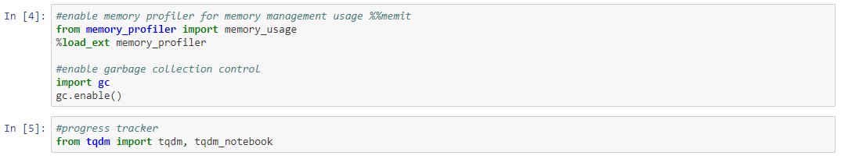

Slide 9
Audio file loading control flag
# when set to TRUE, training data get loaded from a saved serialized data object file
# All audio files data get saved to a serialized object file to save reloading time on training runs
# Note:
# On first time run, if serialized file doesn't exist, this flag will get overrident
# SKIP_AUDIO_RELOAD = False

Slide 10
Dataset exploration
INPUT_PATH='../input' TRAIN_INPUT=INPUT_PATH+'/train' TRAIN_AUDIO_DIR=TRAIN_INPUT+'/Train' TEST_INPUT=INPUT_PATH+'/test' TEST_AUDIO_DIR=TEST_INPUT+'/Test‘
def load_input_data(pd, filepath):
# Read Data
data = pd.read_csv(filepath) return data

Slide 11
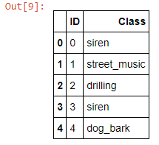
# training file
TRAIN_FILE=TRAIN_INPUT+'/train.csv'
#show info train_input=load_input_data(pd,TRAIN_FILE) train_input.head()

Slide 12
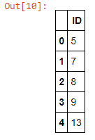
# training file
TEST_FILE=TEST_INPUT+'/test.csv'
#show info
test_input=load_input_data(pd,TEST_FILE) test_input.head()

Slide 13
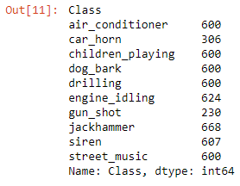
#labels
valid_train_label = train_input[['Class']] #x=data['label'].unique()
valid_train_label.count()
#unique classes
x = train_input.groupby('Class')['Class'].count() x

Slide 14
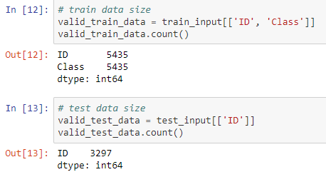

Slide 15
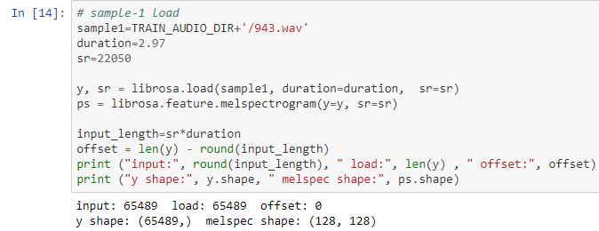
Check input audio file samples

Slide 16
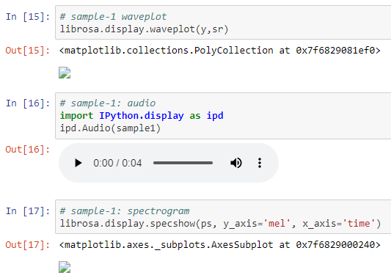

Slide 17
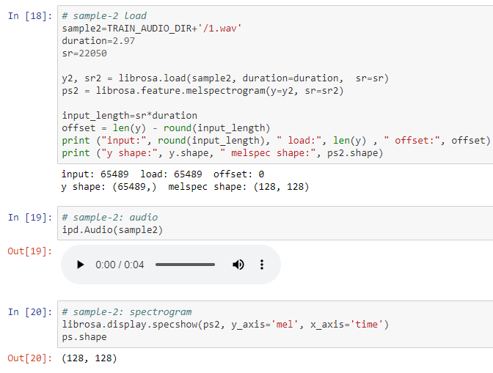

Slide 18
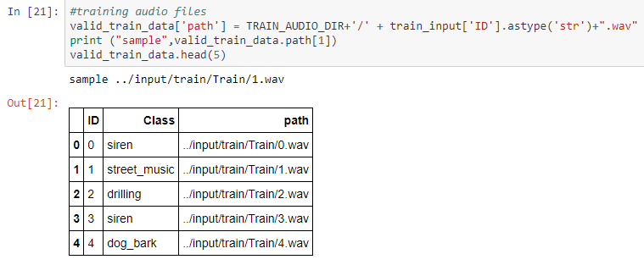
Prepare data file loading

Slide 19
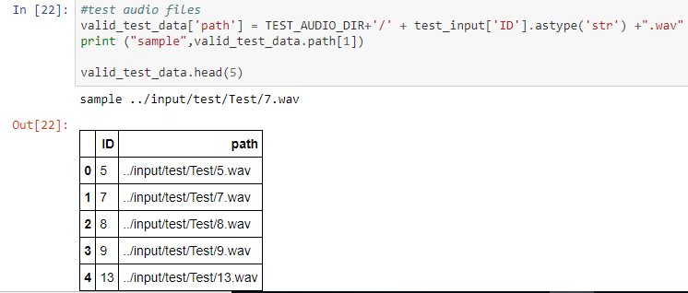

Slide 20
Loading audio file and features
# set duration on audio loading to make audio content to ensure each training data have same size.
def audio_norm(data):
max_data = np.max(data)
min_data = np.min(data)
data = (data-min_data)/(max_data-min_data+0.0001) return data-0.5
#fix the load audio file size
audio_play_duration=2.97
def load_audio_file(file_path, duration=2.97, sr=22050):
input_length=sr*duration

Slide 21
y, sr = librosa.load(file_path,sr=sr, duration=duration)
dur = librosa.get_duration(y=y)
if (round(dur) < duration):
offset = len(y) - round(input_length)
print ("fixing audio length :", file_path)
print ("input:", round(input_length), " load:", len(y) , " offset:", offset)
y = librosa.util.fix_length(y, round(input_length))
# y = audio_norm(y)
# using a pre-computed power spectrogram
# Short-time Fourier transform (STFT)
#D = np.abs(librosa.stft(y))**2
#ps = librosa.feature.melspectrogram(S=D)
ps = librosa.feature.melspectrogram(y=y, sr=sr)
return ps

Slide 22
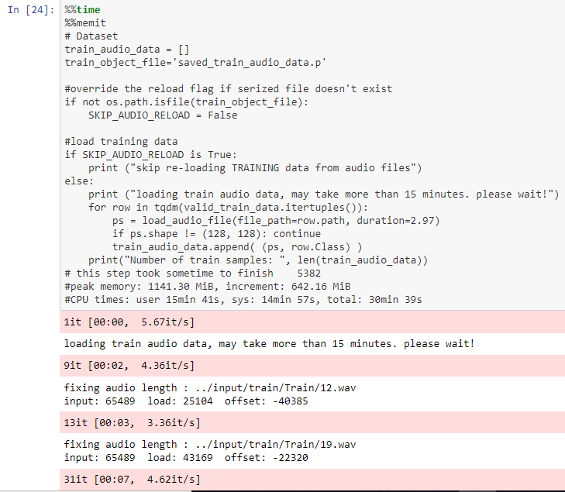

Slide 23
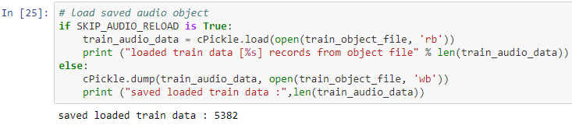

Slide 24
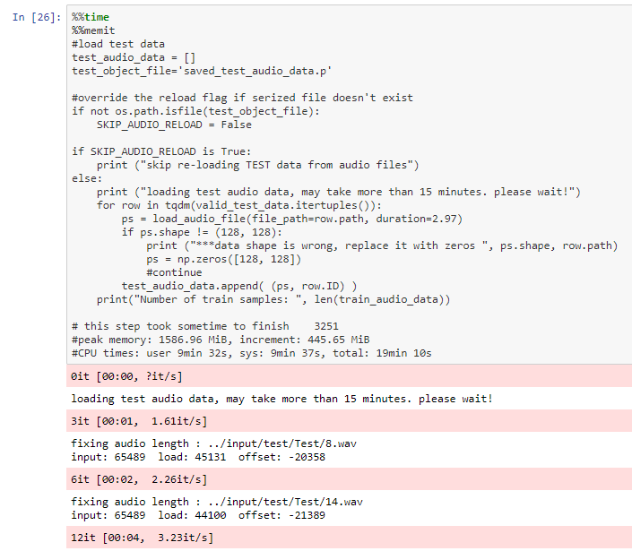

Slide 25
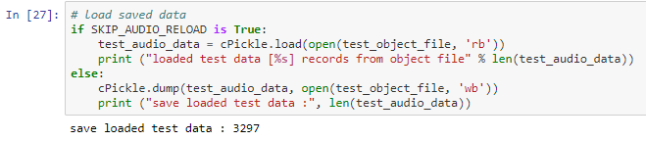

Slide 26
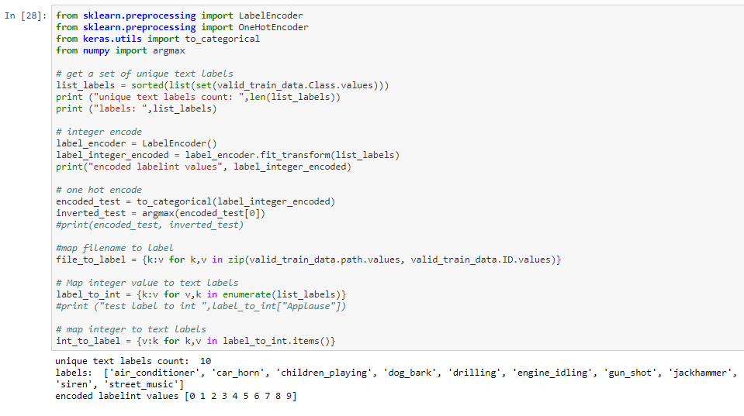
Prepare data for training
Encode labels

Slide 27
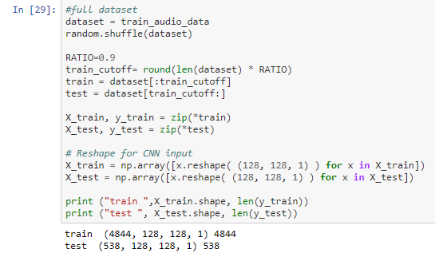
Split up data into train, test and validation

Slide 28
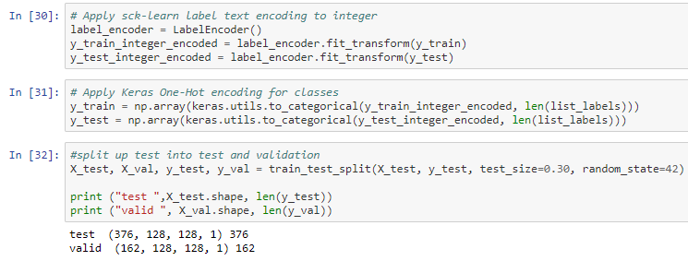

Slide 29
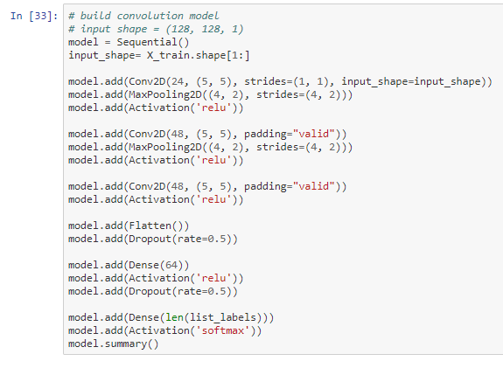

Slide 30
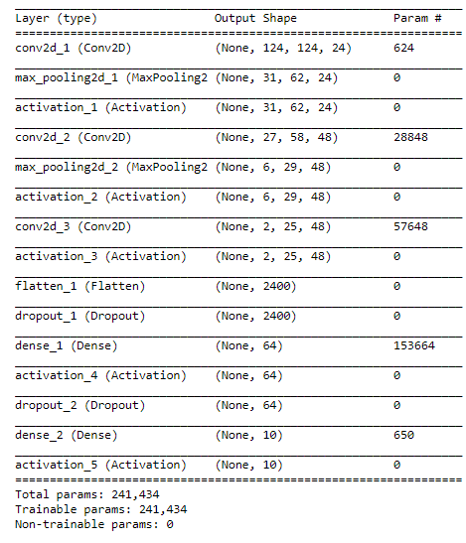
Out [33]

Slide 31
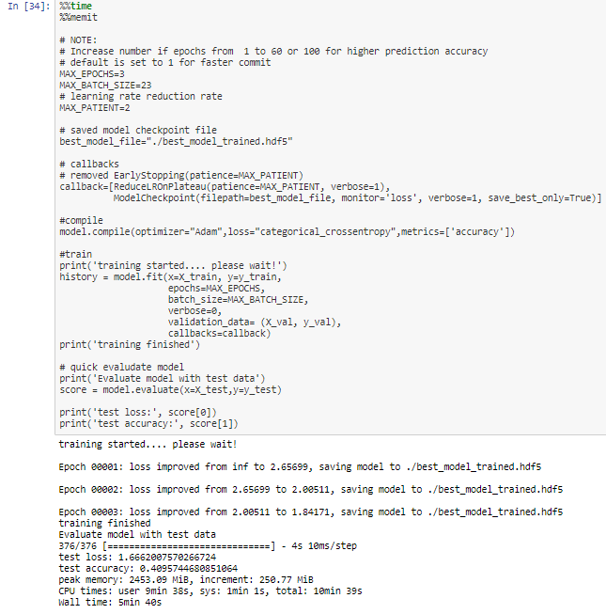

Slide 32
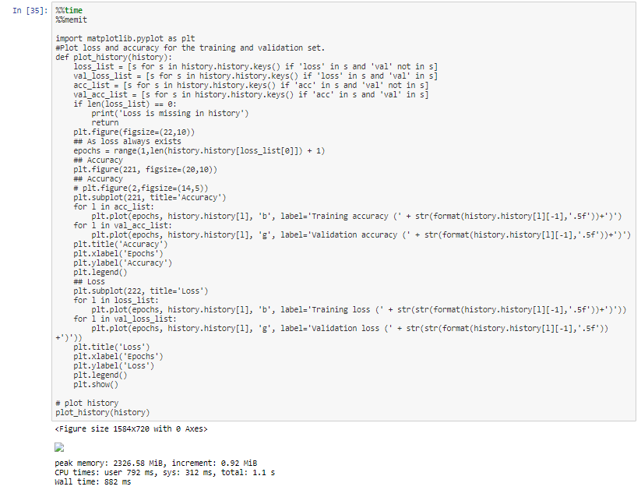

Slide 33
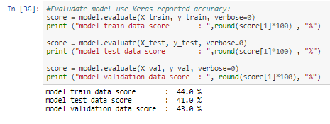
Model Evaluation

Slide 34
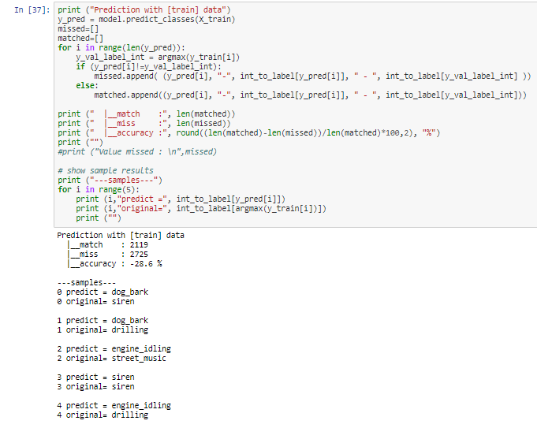
Prediction test

Slide 35
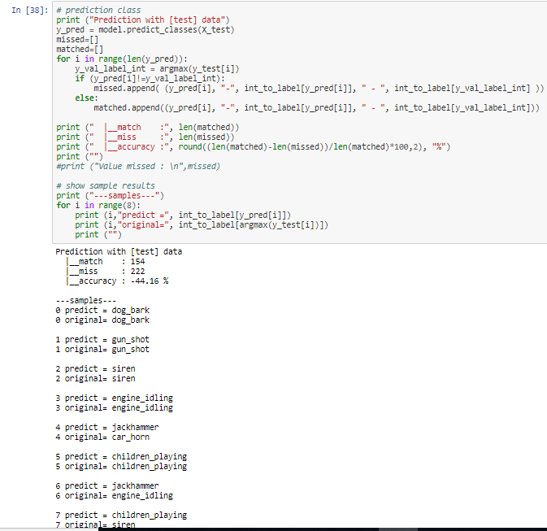

Slide 36
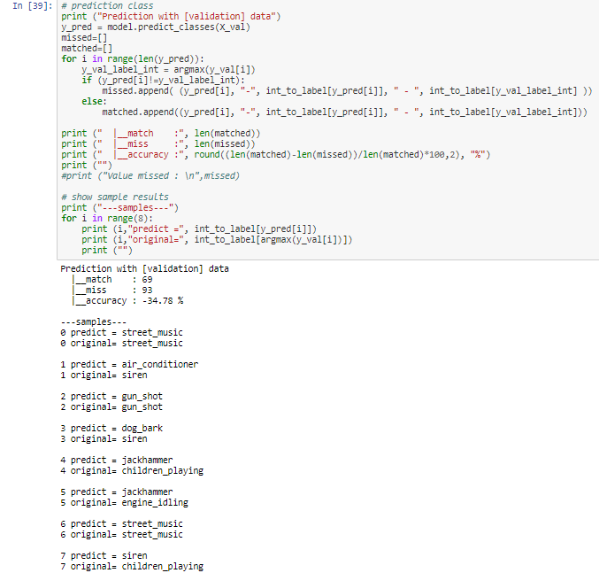

Slide 37
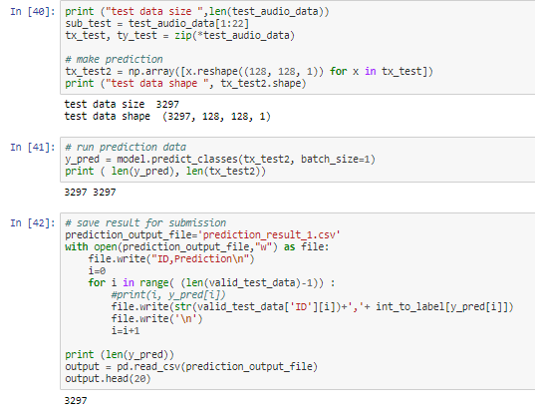
Prepcare Submission

Slide 38
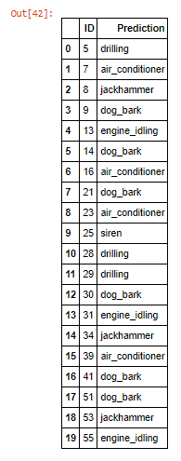

Slide 39
Thank You
LELLA KRANTHI KUMAR
405119002

